Slide 1
Council opinion about the LAPP
March 2016

Slide 2
Summary

Slide 3
This presentation
Why we did the research
How we carried it out
Whom we included
What we found out:
Insurance decision making considerations
Factors important to retaining current members
Reasons past members exited
Why non-members have never been in the LAPP
Opportunities to increase retention and attract past and non-members

Slide 4
Background

Slide 5
Background
In 2010, the majority of councils were members of the LAPP
Since the fund’s depletion, as a result of the Canterbury earthquakes, numbers have dwindled to just 32 of the 82 councils
Exited councils have either insured privately or joined regional LASS
To avert further decline and attract more councils, Civic Assurance are developing a marketing plan
“Because our LASS has now grown, we’ve now got huge purchasing power.”
“The commercial insurance market worked very hard to try to deliver a product to the 20 or so councils that were exiting the LAPP and were able to come up with something pretty attractive.”

Slide 6
Purpose and design

Slide 7
Research objectives
To inform the marketing plan by providing an understanding of:
Current members’ value of the LAPP and current satisfaction
Past members’ reasons for exiting and what would encourage them to re-join
Non-members’ reasons for never having joined
Opportunities for improvements, including Civic Assurance’s performance, to encourage retention and attract past and non-members

Slide 8
Research Design
Two streams of research between 25 September and 11 December 2016
12 qualitative interviews completed by telephone or in person to inform the survey and provide detailed insight
Online or telephone survey completed by 35 councils
60%
of councils included in the research

Slide 9
Findings

Slide 10
Target audience
Decision makers in relation to purchasing infrastructure insurance include: Chief Financial Officers, Asset Managers, Corporate/Business services Managers, Property and Insurance Officers
Although some involve Councillors and/or Mayors in final decisions, they are not seen as the primary target audience
A number of councils also seek independent advice from insurance brokers

Slide 11
Insurance decision making factors
Key product related factors
Financial surety of cover
Degree of risk exposure
Secondary factors
Contract transparency
Pricing/deductible amounts
Cost of premium/contribution
Provider related factors
Independent advice
Customer orientation

Slide 12
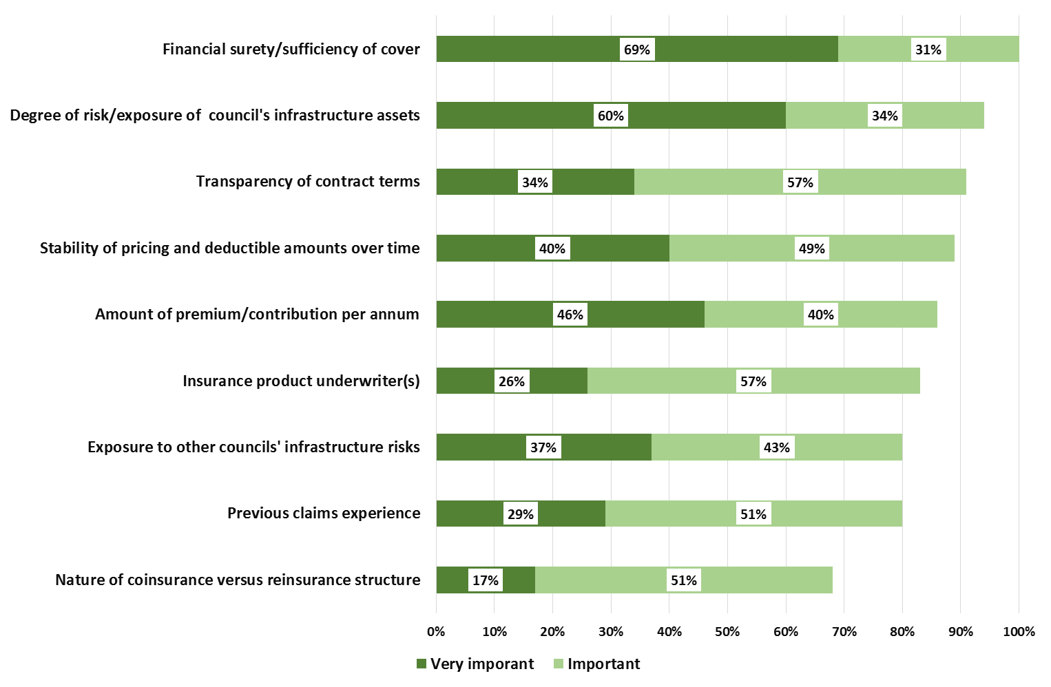
Product related factors

Slide 13
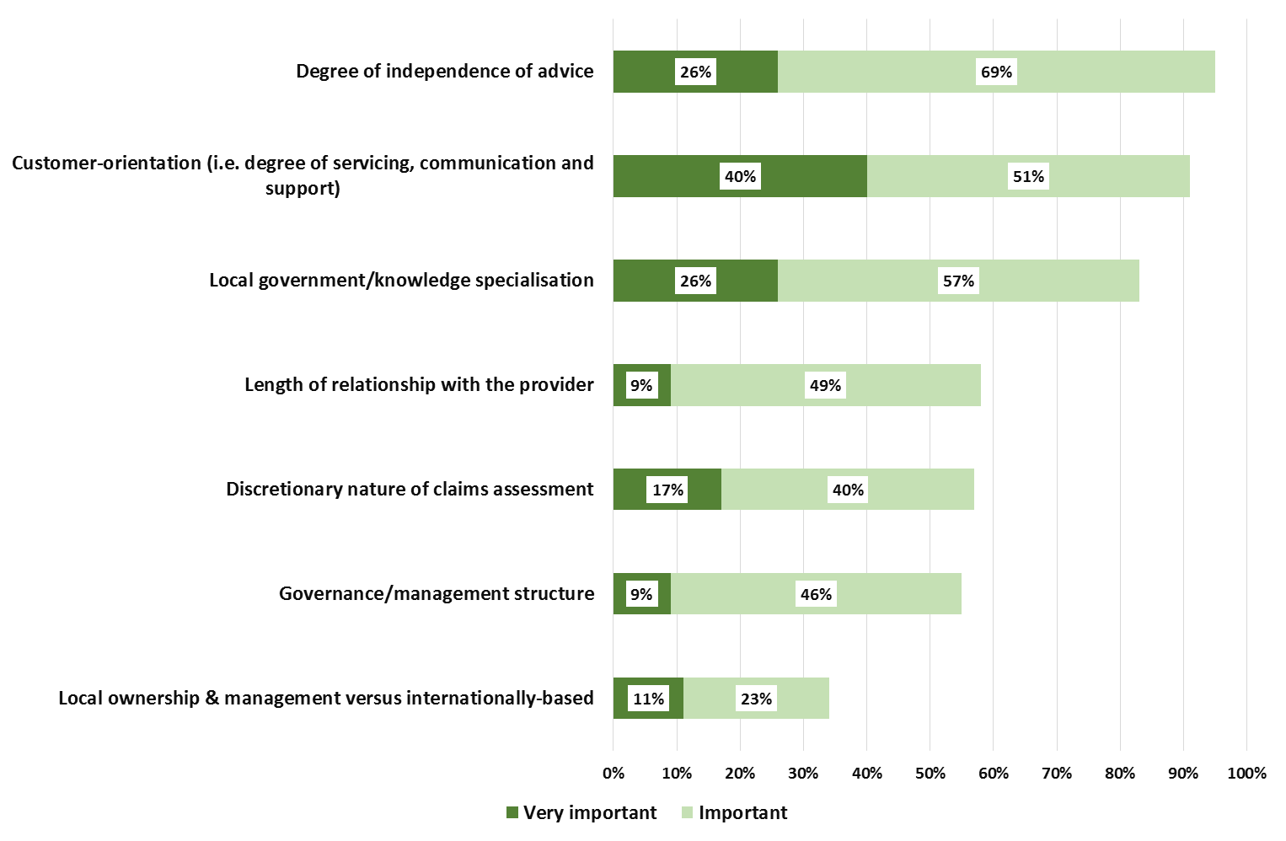
Provider related factors

Slide 14
Retention of current members
Key product related factors
Financial surety of cover
Degree of risk exposure
Secondary factors
Cost of contribution
Stability of pricing
Reinsurance underwriters
Provider related factors
Local government knowledge & specialisation
Trustee flexibility in claims assessments
Degree of independent advice

Slide 15
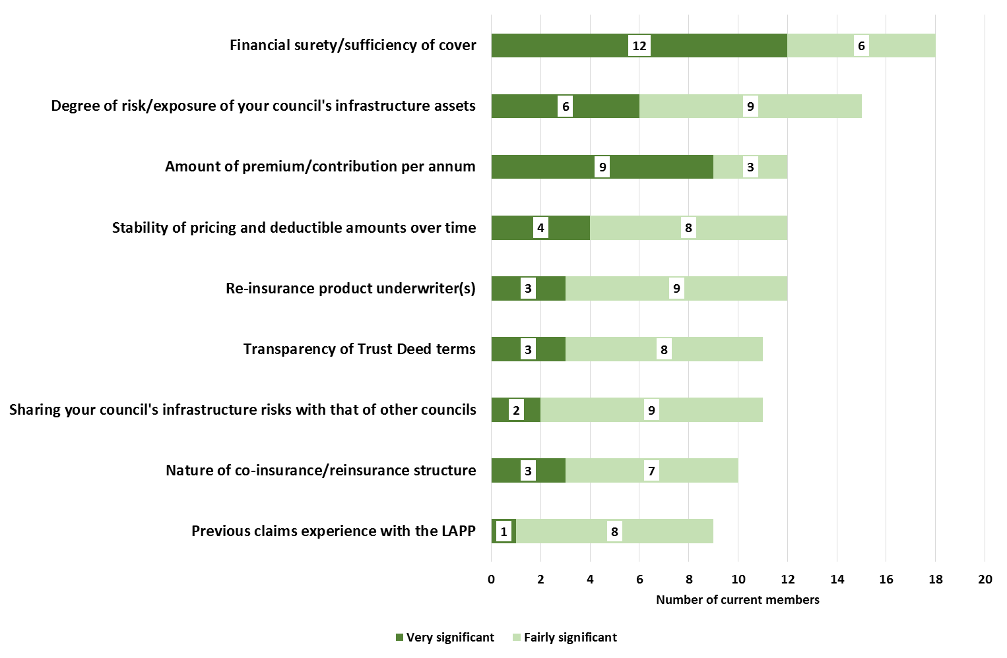
Retention – LAPP related factors

Slide 16
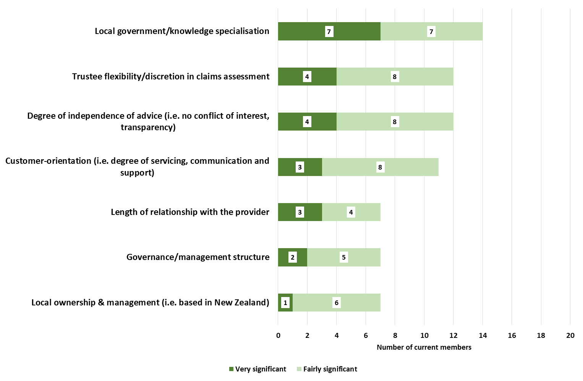
Retention – provider related factors

Slide 17
Perceived strengths of the LAPP
Collective philosophy underpinning the fund
Appreciation that the LAPP filled the gap when no other insurers would
Benefits of investing in a mutual fund
Limited membership making the fund more sustainable
“Philosophically, it was about banding together as a group of councils for a common goal.”
“It’s a premium, plus investment to build.”
“LAPP was established simply because the commercial market couldn’t provide the cover that territorial and regional councils required.”
“If people are pulling out, the pool that’s available versus the risk gets bigger… To our benefit potentially, down the track.”

Slide 18
Strengths of members’ relationship with Civic Assurance
Long term relationship
Support for local government
NZ owned and managed
Confidence in governance
Positive claims experiences
Satisfaction with communications
“A partnership of sorts… A mutual tends to suggest you’re in something for the long haul.”
“The trustees… I know where their experience is from and have confidence in them.”
“It’s a specialised local government system, driven by people in New Zealand with local government at heart.”
“The service from the LAPP fund was excellent. If fact, you could probably say with hindsight, they were too good.”

Slide 19
Risk of losing current members
More than half current members have considered exiting
Councils with low risk exposure are less likely to value the LAPP
Councils with high risk exposure have concerns about the LAPP’s ability to cover their assets in the event of a major natural disaster
Provider related factors are not a key consideration
“What we did seriously have to look at was whether LAPP had the re-insurance to support the asset base they were insuring… it’s building up again, but we did seriously look at it two years ago, when the decision was finally made to stay.”

Slide 20
Past members’ main reasons for exiting
Cost of the annual contribution
Concerns about financial surety/sufficiency of cover
Exposure to other councils’ risk
Degree of the council’s own risk exposure
Again, provider/service related factors were not
a key part of their consideration

Slide 21
Perceived weaknesses of the LAPP
Depletion of the fund, increased contributions and liability to fund other councils in the event of a major natural disaster
Level of risk involved in LAPP’s ability to provide cover
Perceived limitations of wholesale reinsurers
Depleted membership
“As a result of Christchurch, that led to LAPP’s problems and its inability to provide us with the cover that we required.”
“LAPP came up with the idea that we’ll pay the contribution and, if there was a natural disaster, everyone will pay up to five times their contribution, up to twice a year. That meant we were going to be up for quite a lot of money.”
“LAPP are limited, in terms of their pool, whereas, we’re dealing on the international market.”

Slide 22
Perceived shortcomings of Civic Assurance
Lack of transparency and clarity in risk assessments and cover
Dissatisfaction with level of communication and channels (promoting the LAPP to Councillors, rather than those who are involved in insurance decisions)
Lack of independent brokerage
Perceived conflicts of interest with retention of Christchurch board members
Requirement to give a year’s notice
“The whole point of a broker is there’s some form of independence.”
“That expertise that Aon were able to bring has enticed councils away from the LAPP, because they weren’t seeing the transparency that LAPP uses; the Australian people.”
“I certainly haven’t had a phone call, or a visit, or anything like that… Aon, as a broker, are held at arms length… Whereas, we get a political lobbying for LAPP to stay in the tent.”

Slide 23
Non-members’ insurance arrangements
Most non-members are self-insured, due to:
Low risk exposure
Concerns about other councils’ infrastructure risk, compared to their own
The cost of contribution/premium
“We are a relatively small council and we have very little in the way of infrastructure. So, that’s been our policy to date. Self-insurance.”
“Our risk is probably a lot smaller than a lot of other councils and, potentially, we’d be propping them up and us having not much benefit.”

Slide 24
Opportunities to increase retention and attract past and non-members
More than half of all councils surveyed expressed an interest in proposed enhancements
New market opportunities
Working collaboratively with councils to assess their risk and cover requirements (greater transparency and clarity)
Enhanced service support (in line with brokers)
Providing insurance cover for currently uninsurable assets (bridges, roading)
Having separate LAPP funds for urban vs. provincial councils (ameliorating concerns about exposure to other councils’ risks)
“The LAPP fund should be structured in a way to minimise risk. Let’s say we had three LAPP funds… Because they’re all geographically distant from each other, it’s unlikely they’re all going to be hit in the same year.”
“We just need to see more of them and they need to be seen to be working closer with us.”

Slide 25
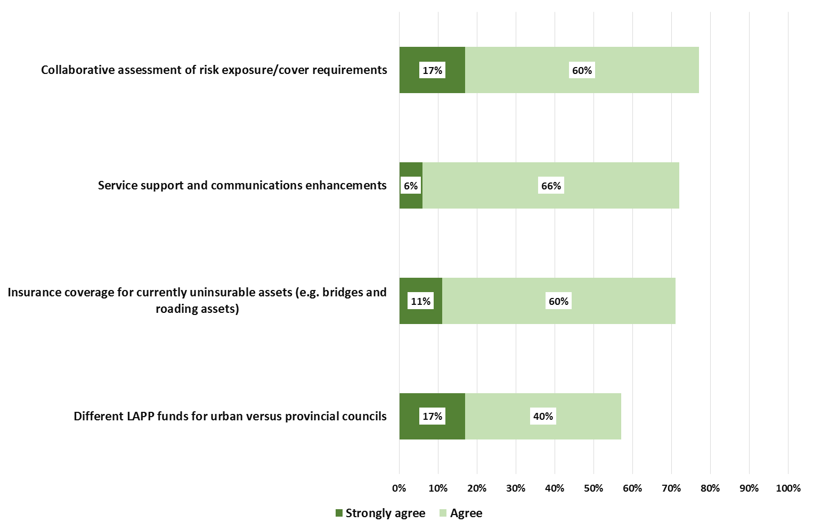
Areas of opportunity

